Slide 1
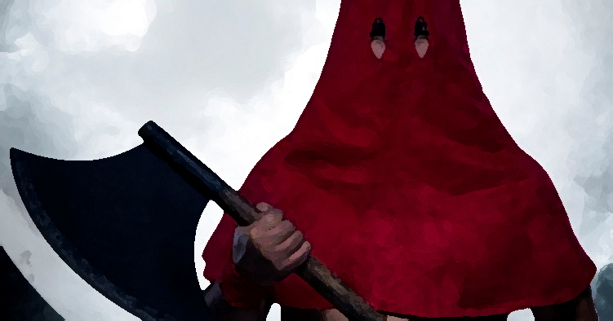
Occupation? Executioner!
(Sins that incur God’s wrath)
Colossians 3:5-6

Slide 2
Colossians 3:5-6
Paul’s writings: “dead in sin” or “dead to sin”

Slide 3
Colossians 3:5-6
Paul’s writings: “dead in sin” or “dead to sin”
As believers – “work in progress!”

Slide 4
Colossians 3:5-6
Paul’s writings: “dead in sin” or “dead to sin”
As believers – “work in progress!”
Already seen legalist’s solution – “don’t handle, taste, touch!”

Slide 5
Colossians 3:5-6
Paul’s writings: “dead in sin” or “dead to sin”
As believers – “work in progress!”
Already seen legalist’s solution – “don’t handle, taste, touch!”
Colossians 3 – we died with Christ, were raised with him.

Slide 6
Colossians 3:5-6
Paul’s writings: “dead in sin” or “dead to sin”
As believers – “work in progress!”
Already seen legalist’s solution – “don’t handle, taste, touch!”
Colossians 3 – we died with Christ, were raised with him.
How then should we live?
John Owen: “kill a sin or part of a sin every day!”

Slide 7
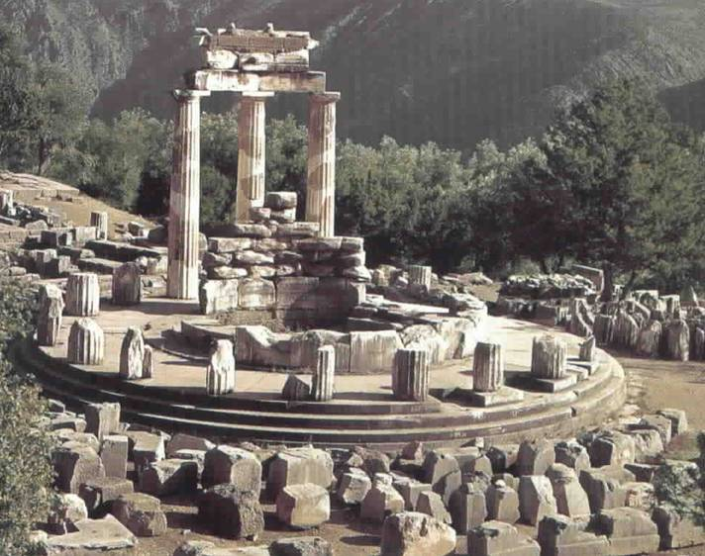
Colossians 3:5-6
1. The reality of what we are – “γνῶθι σεαυτόν” (know thyself)

Slide 8
Colossians 3:5-6
1. The reality of what we are – “γνῶθι σεαυτόν” (know thyself)
Two popular non-Christian analyses:

Slide 9
Colossians 3:5-6
1. The reality of what we are – “γνῶθι σεαυτόν” (know thyself)
Two popular non-Christian analyses:
Reason is good, therefore man is good

Slide 10
Colossians 3:5-6
1. The reality of what we are – “γνῶθι σεαυτόν” (know thyself)
Two popular non-Christian analyses:
Reason is good, therefore man is good
Man is matter, the result of natural selection

Slide 11
Colossians 3:5-6
1. The reality of what we are – “γνῶθι σεαυτόν” (know thyself)
Two popular non-Christian analyses:
Reason is good, therefore man is good
Man is matter, the result of natural selection
General dissatisfaction!

Slide 12
Colossians 3:5-6
1. The reality of what we are – “γνῶθι σεαυτόν” (know thyself)
Two popular non-Christian analyses
Christian analysis

Slide 13
Colossians 3:5-6
1. The reality of what we are – “γνῶθι σεαυτόν” (know thyself)
Two popular non-Christian analyses
Christian analysis
“You have made us for yourself O Lord, and our hearts are restless until they rest in you…” Augustine of Hippo

Slide 14
Colossians 3:5-6
1. The reality of what we are – “γνῶθι σεαυτόν” (know thyself)
Two popular non-Christian analyses
Christian analysis
“You have made us for yourself O Lord, and our hearts are restless until they rest in you…” Augustine of Hippo
“What else does this craving and this helplessness proclaim? There used to be in man a true happiness of which all that remains is the empty print and trace. In vain he tries to fill it with everything around him, but none can help, since this infinite abyss can only be filled by God himself.” Pascal

Slide 15
Colossians 3:5-6
1. The reality of what we are – “γνῶθι σεαυτόν” (know thyself)
Two popular non-Christian analyses
Christian analysis
Genesis 1-3
Man is God’s creation, his vice-regent

Slide 16
Colossians 3:5-6
1. The reality of what we are – “γνῶθι σεαυτόν” (know thyself)
Two popular non-Christian analyses
Christian analysis
Genesis 1-3
Man is God’s creation, his vice-regent
Temptation and fall

Slide 17
Colossians 3:5-6
1. The reality of what we are – “γνῶθι σεαυτόν” (know thyself)
Two popular non-Christian analyses
Christian analysis
Genesis 1-3
Man is God’s creation, his vice-regent
Temptation and fall
Sin is unfaithfulness

Slide 18
Colossians 3:5-6
1. The reality of what we are – “γνῶθι σεαυτόν” (know thyself)
Two popular non-Christian analyses
Christian analysis
Genesis 1-3
Man is God’s creation, his vice-regent
Temptation and fall
Sin is unfaithfulness
Sin is rebellion

Slide 19
Colossians 3:5-6
1. The reality of what we are – “γνῶθι σεαυτόν” (know thyself)
Two popular non-Christian analyses
Christian analysis
Genesis 1-3
Man is God’s creation, his vice-regent
Temptation and fall
Sin is unfaithfulness
Sin is rebellion
Sin is pride

Slide 20
Colossians 3:5-6
The reality of what we are
The reality of what we’ve become
Colossians 1:13-14; 1:22; 2:11-14; 2:20

Slide 21
Colossians 3:5-6
The reality of what we are
The reality of what we’ve become
Colossians 1:13-14; 1:22; 2:11-14; 2:20
Wonderful, but still plagued by sin!

Slide 22
Colossians 3:5-6
The reality of what we are
The reality of what we’ve become
The reality of what needs dealing with!

Slide 23
Colossians 3:5-6
The reality of what we are
The reality of what we’ve become
The reality of what needs dealing with!
“Put to death whatever belongs to your earthly nature” (NIV)
“Don’t be controlled by your body” (CEV) – Contemporary English Version

Slide 24
Colossians 3:5-6
The reality of what we are
The reality of what we’ve become
The reality of what needs dealing with!
“Put to death whatever belongs to your earthly nature” (NIV)
“Don’t be controlled by your body” (CEV) – Contemporary English Version
Jesus: If your hand causes you to sin, cut it off. It is better for you to enter life maimed than with two hands to go into hell. And if your foot causes you to sin, cut it off. It is better for you to enter life crippled than to have two feet and be thrown into hell. And if your eye causes you to sin, pluck it out. It is better for you to enter the kingdom of God with one eye than to have two eyes and be thrown into hell” Mark 9:43-47

Slide 25
Colossians 3:5-6
The reality of what we are
The reality of what we’ve become
The reality of what needs dealing with!
Jesus: Mark 9:43-47
Paul: “the acts of our sinful nature are obvious: sexual immorality, impurity and debauchery, idolatry and witchcraft, hatred, discord, jealousy, fits of rage, selfish ambition, dissensions, factions, envy, drunkenness, orgies and the like. I warn you, as I did before, that those who live like this will not inherit the kingdom of God” (Galatians 5:19-21).

Slide 26
Colossians 3:5-6
The reality of what we are
The reality of what we’ve become
The reality of what needs dealing with!
Immorality

Slide 27
Colossians 3:5-6
The reality of what we are
The reality of what we’ve become
The reality of what needs dealing with!
Immorality
Impurity

Slide 28
Colossians 3:5-6
The reality of what we are
The reality of what we’ve become
The reality of what needs dealing with!
Immorality
Impurity
Lust

Slide 29
Colossians 3:5-6
The reality of what we are
The reality of what we’ve become
The reality of what needs dealing with!
Immorality
Impurity
Lust
Evil desires

Slide 30
Colossians 3:5-6
The reality of what we are
The reality of what we’ve become
The reality of what needs dealing with!
Immorality
Impurity
Lust
Evil desires
Greed

Slide 31
Colossians 3:5-6
The reality of what we are
The reality of what we’ve become
The reality of what needs dealing with!
The wrath of God is coming

Slide 32
Colossians 3:5-6
The reality of what we are
The reality of what we’ve become
The reality of what needs dealing with!
The wrath of God is coming
His wrath is a judicial judgment of evil

Slide 33
Colossians 3:5-6
The reality of what we are
The reality of what we’ve become
The reality of what needs dealing with!
The wrath of God is coming
His wrath is a judicial judgment of evil
OT prophets constantly warned of sins’ consequences

Slide 34
Colossians 3:5-6
The reality of what we are
The reality of what we’ve become
The reality of what needs dealing with!
The wrath of God is coming
His wrath is a judicial judgment of evil
OT prophets constantly warned of sins’ consequences
Fall of Empires - Nineveh, Babylon, Persia, Greece and Rome

Slide 35
Colossians 3:5-6
The reality of what we are
The reality of what we’ve become
The reality of what needs dealing with!
The wrath of God is coming
His wrath is a judicial judgment of evil
OT prophets constantly warned of sins’ consequences
Fall of Empires: Nineveh, Babylon, Persia, Greece and Rome
Redemptive intention – God hates cancer but loves the patient!

Slide 36
Colossians 3:5-6
The reality of what we are
The reality of what we’ve become
The reality of what needs dealing with!
The wrath of God is coming
His wrath is a judicial judgment of evil
OT prophets constantly warned of sins’ consequences
Fall of Empires: Nineveh, Babylon, Persia, Greece and Rome
There is always a redemptive intention – God hates cancer but loves the patient!
Consider the state of our nation

Slide 37
Colossians 3:5-6
The reality of what we are
The reality of what we’ve become
The reality of what needs dealing with!
The wrath of God is coming
Suggestions to becoming victorious:

Slide 38
Colossians 3:5-6
The reality of what we are
The reality of what we’ve become
The reality of what needs dealing with!
The wrath of God is coming
Suggestions to becoming victorious:
Fix our eyes on Jesus

Slide 39
Colossians 3:5-6
The reality of what we are
The reality of what we’ve become
The reality of what needs dealing with!
The wrath of God is coming
Suggestions to becoming victorious:
Fix our eyes on Jesus
Confess that we need help

Slide 40
Colossians 3:5-6
The reality of what we are
The reality of what we’ve become
The reality of what needs dealing with!
The wrath of God is coming
Suggestions to becoming victorious:
Fix our eyes on Jesus
Confess that we need help
Appreciate the true nature of our life in Christ

Slide 41
Colossians 3:5-6
The reality of what we are
The reality of what we’ve become
The reality of what needs dealing with!
The wrath of God is coming
Suggestions to becoming victorious:
Fix our eyes on Jesus
Confess that we need help
Appreciate the true nature of our life in Christ
Be alert to the warning signs

Slide 42
Colossians 3:5-6
The reality of what we are
The reality of what we’ve become
The reality of what needs dealing with!
The wrath of God is coming
Suggestions to becoming victorious:
Fix our eyes on Jesus
Confess that we need help
Appreciate the true nature of our life in Christ
Be alert to the warning signs
Praise God for progress

